Slide 1

Infrastructure To Migrate Amazon RDS
Present By -
MAYUR SUDHIR CHAVHAN
Mentor :
Sakshi Bokade

Slide 2
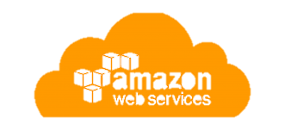
Project Overview-
In this Project, you migrate the web application to use a fully managed Amazon Relational Database Service (Amazon RDS) database (DB) instance instead of a local database instance.
You begin by generating some data on the existing database. This data is migrated to the new Amazon RDS instance.
During the migration process, you build the required components, including two private subnets in different Availability Zones, a security group for the database instance, and the RDS DB instance itself. After the database has been migrated, you reconfigure the café application to use the Amazon RDS instance instead of a local database.
Technology Use-
AWS RDS
AWS IAM
AWS EC2
AWS VPC
AWS S3

Slide 3
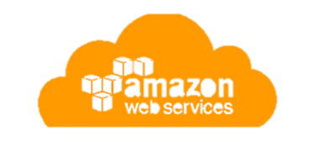

Objectives -
Create an Amazon RDS MariaDB instance by using the
AWS CLI.
Migrate data from a MariaDB database on an EC2 instance
to an Amazon RDS MariaDB instance.
Monitor the Amazon RDS instance by using Amazon
CloudWatch metrics.

Slide 4
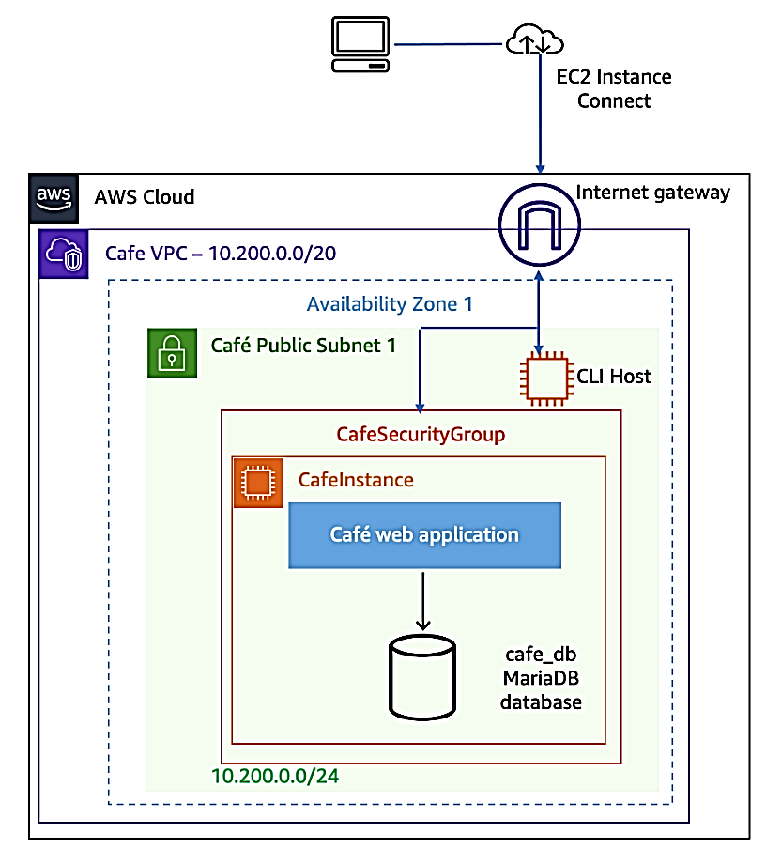
Starting architecture -
The following diagram illustrates the topology of the cafe web application runtime environment before the migration. The application database runs in an Amazon Elastic Compute Cloud (Amazon EC2) Linux, Apache, MySQL, and PHP (LAMP) instance along with the application code. The instance has a T3 small instance type and runs in a public subnet so that internet clients can access the website. A CLI Host instance resides in the same subnet to facilitate the administration of the instance by using the AWS Command Line Interface (AWS CLI).

Slide 5
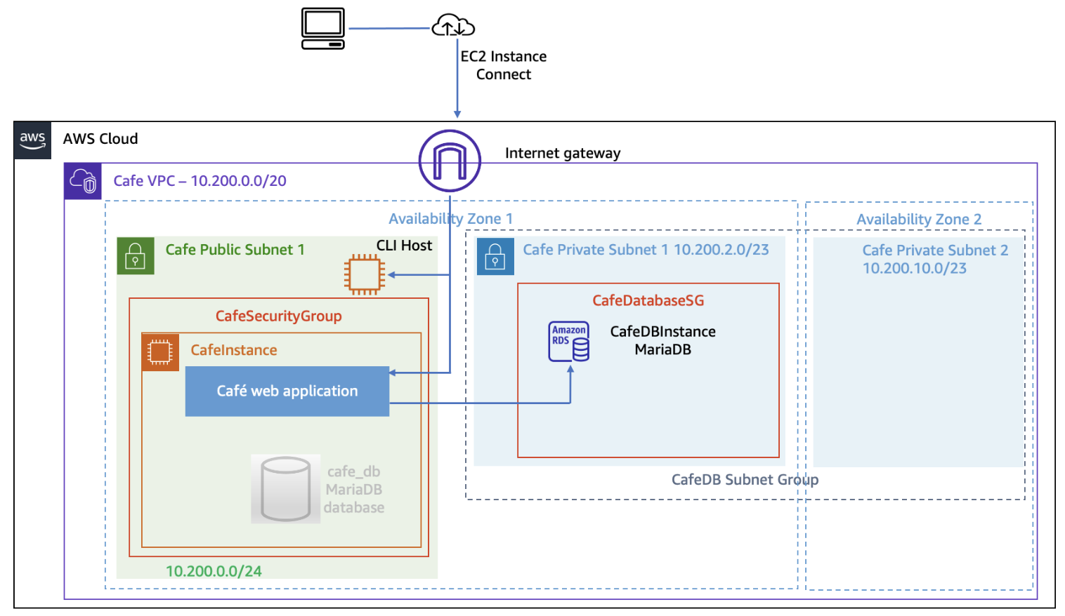
Final architecture –
The following diagram illustrates the topology of the café web application runtime environment after the migration.
You migrate the local cafe database to an Amazon RDS database that resides outside the instance. The Amazon RDS database is deployed in the same virtual private cloud (VPC) as the instance.

Slide 6
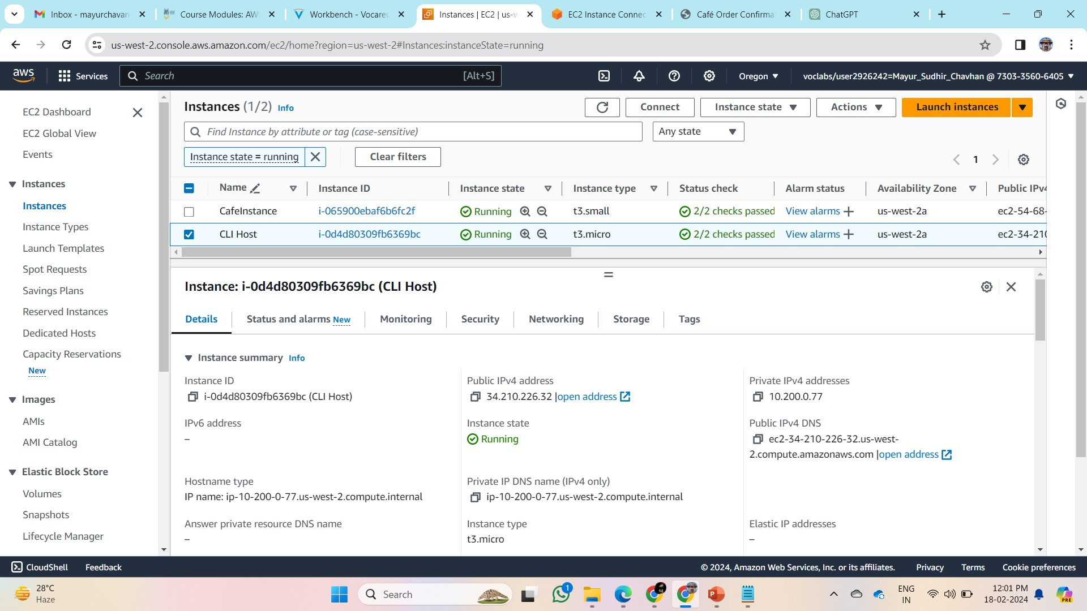
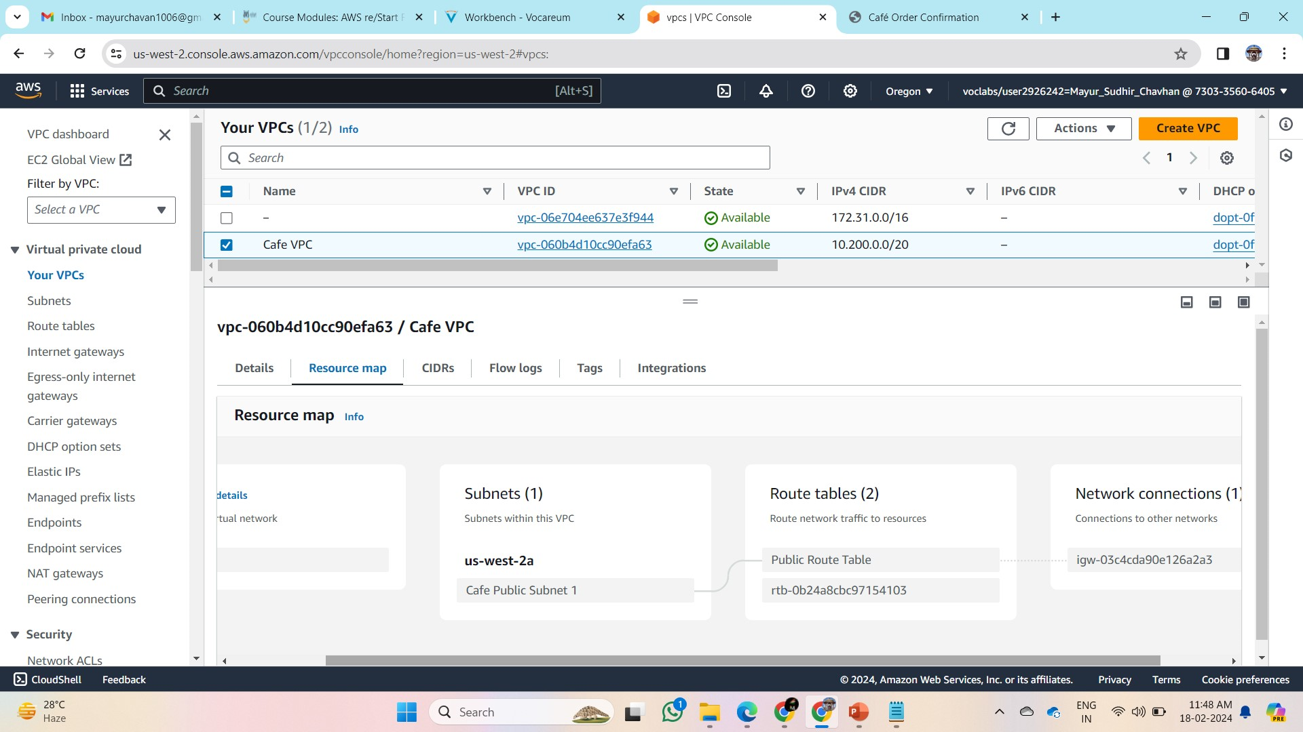
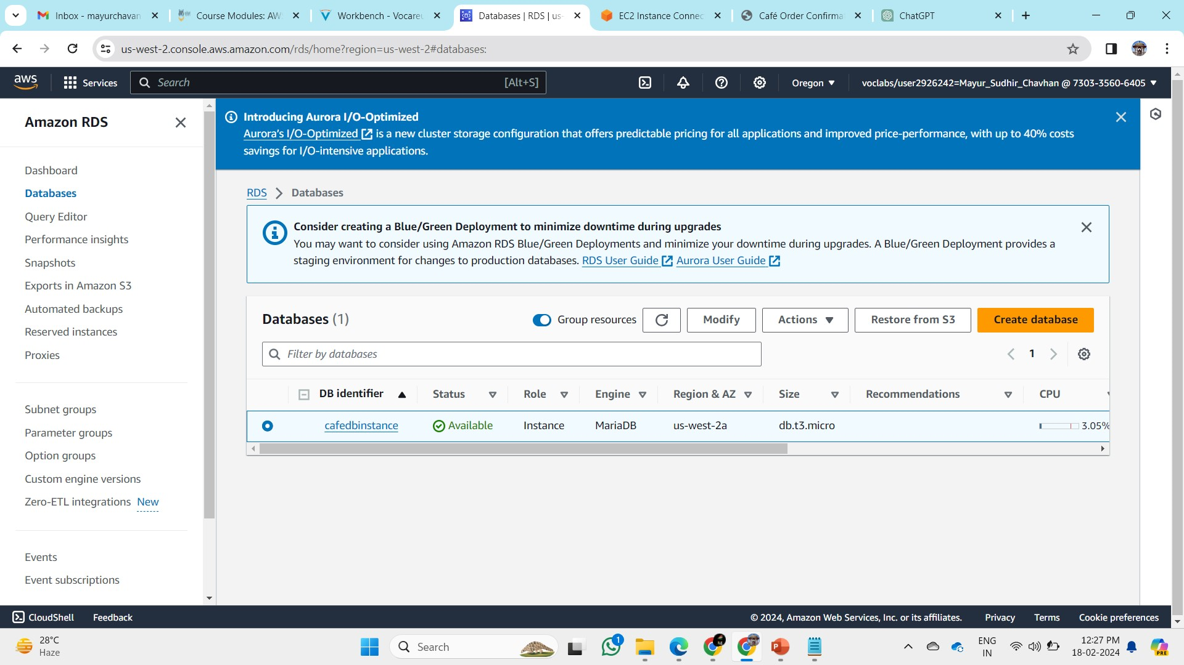
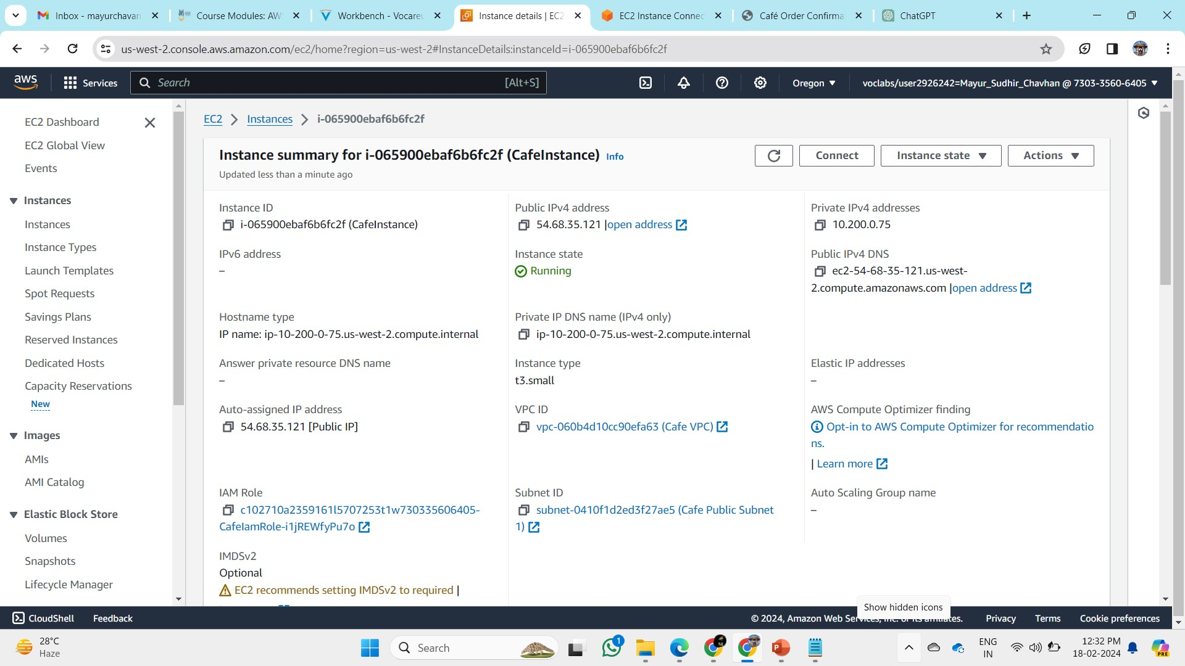
RDS- CafeDBInstance
VPC – Café VPC
Instance- CLI Host
Instance- CafeInstance

Slide 7
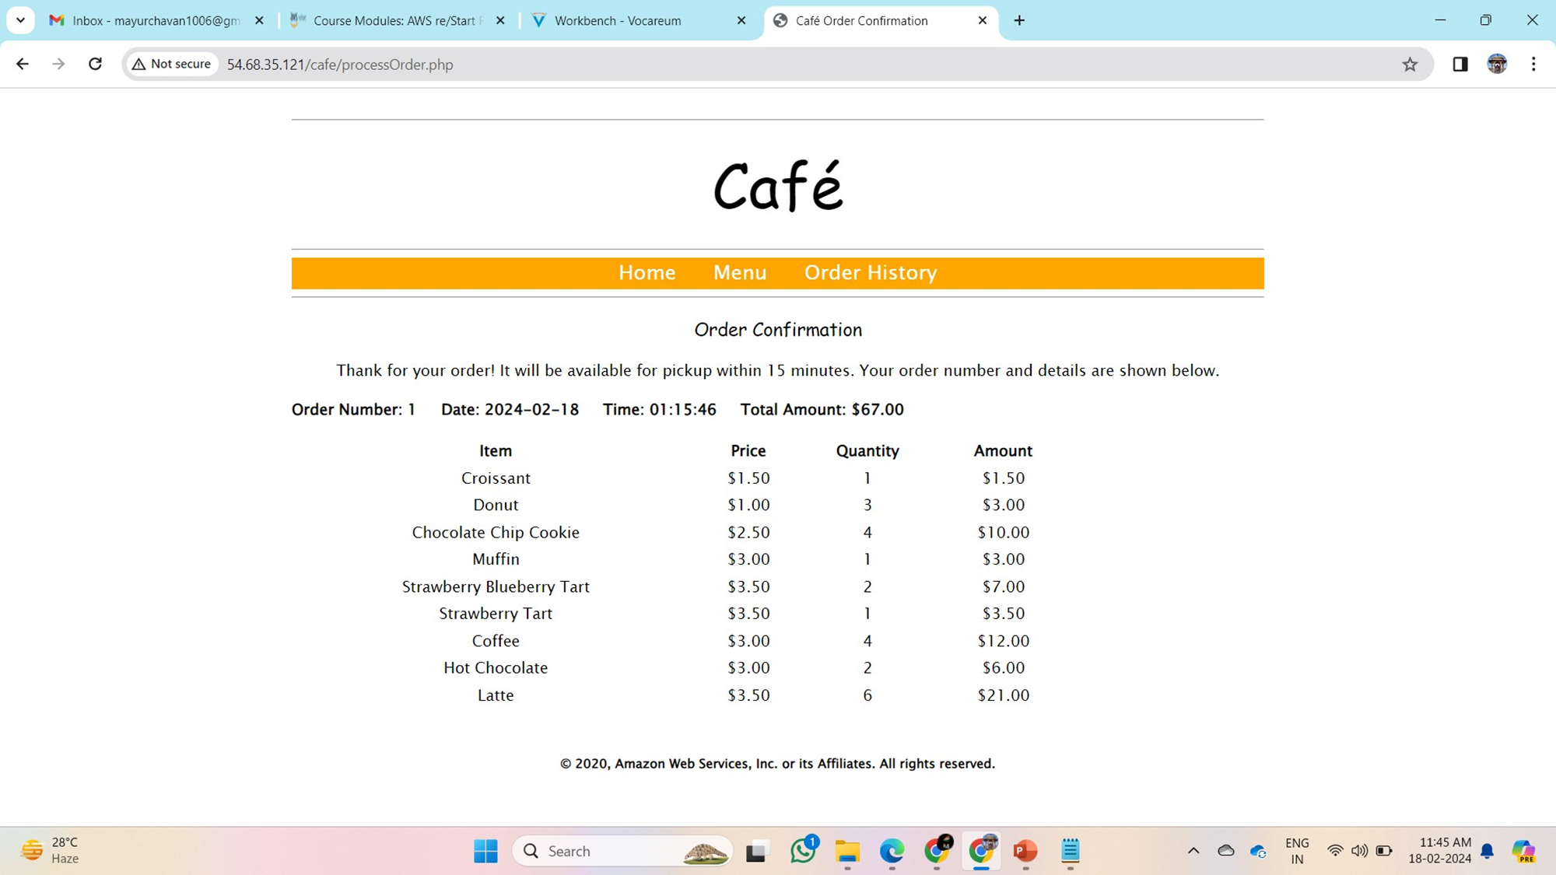
Step 1: Generating Order Data on Cafe Website
Open Cafe Website
Place Order
Go to Menu.
Add at least one of each item.
Choose "Submit Order."
Record Order History
Visit Order History page.
Note the number of placed orders.

Slide 8
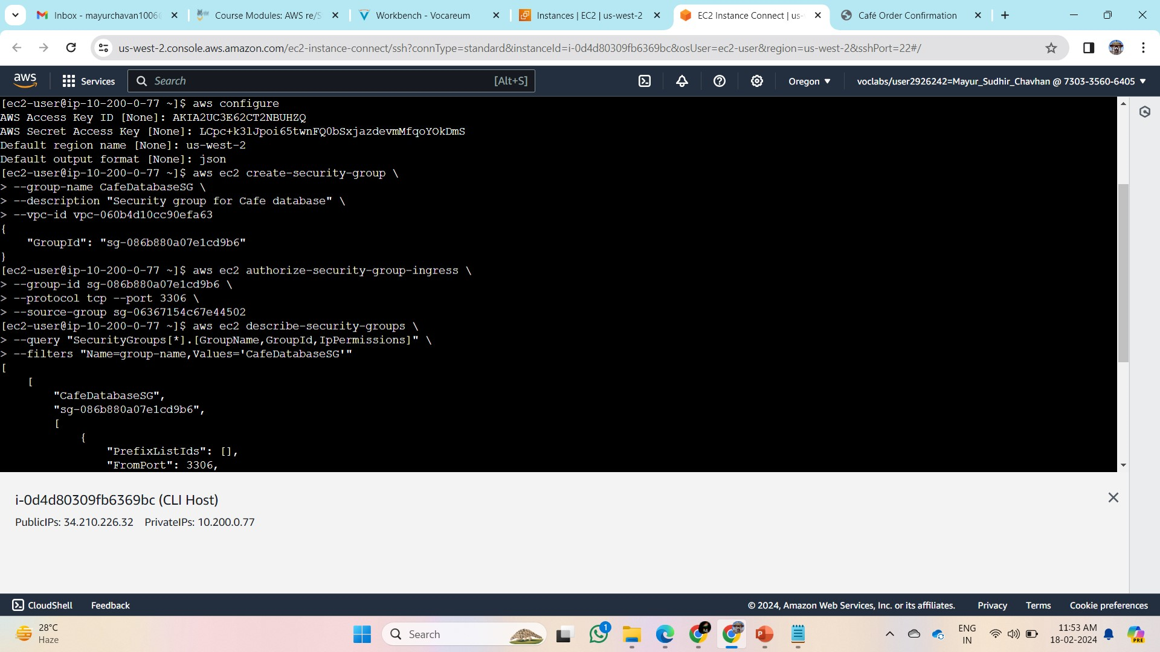
Step 2: Creating an Amazon RDS instance by using the AWS CLI
Connecting to the CLI Host Instance
→Open EC2 Management Console.
→Select CLI Host instance.
→Choose Connect using EC2 Instance Connect.
II. Configuring AWS CLI
→Run aws configure.
→Enter Access Key ID, Secret Access Key, Default region name, and Default output format.
III. Creating Prerequisite Components
→Create CafeDatabaseSG Security Group.
→Authorize inbound rule for MySQL (port 3306).
→Create two private subnets.
→Create CafeDB Subnet Group.

Slide 9
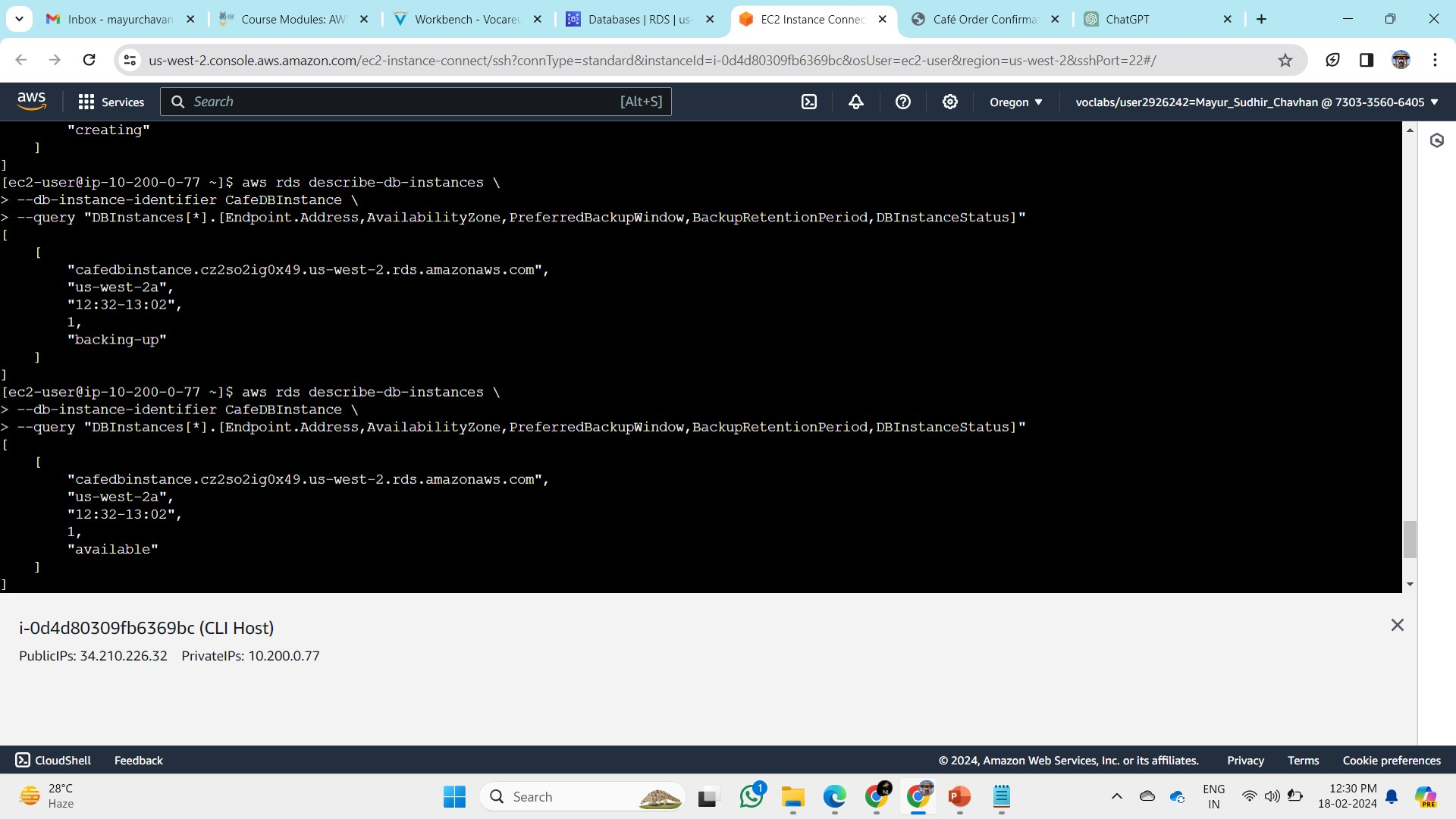
IV. Creating Amazon RDS MariaDB Instance
→Create CafeDBInstance:
Engine: MariaDB (v10.5.13)
Instance Class: db.t3.micro
Allocated Storage: 20 GB
Availability Zone: Café Instance AZ
DB Subnet Group: CaféDB Subnet Group
VPC Security Groups: CafeDatabaseSG
Public Accessibility: No
Username: root
Password: Re:Start!9
Check instance status:
→Run aws rds describe-db-instances --db-instance-identifier CafeDBInstance --query "DBInstances[*].[Endpoint.Address,AvailabilityZone,DBInstance Status]"
→Wait for the status to change from creating to available.
→Record RDS Instance Database Endpoint Address:
cafedbinstance.xxxxxxx.us-west-2.rds.amazonaws.com

Slide 10
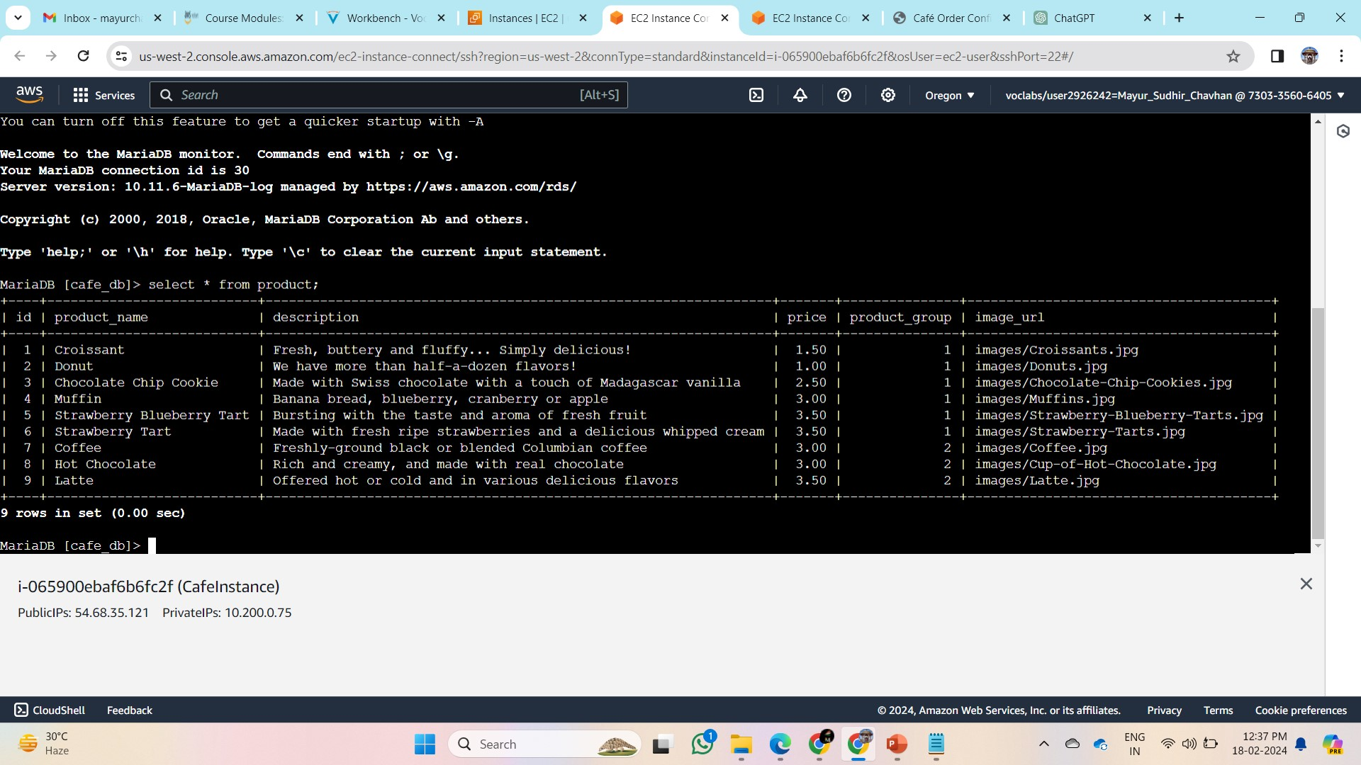
Step 3: Migrating Application Data to Amazon RDS Instance
Data Migration Steps
Connect to CafeInstance
Use EC2 Instance Connect.
Follow previous instructions to connect.
Create Local Database Backup
Use mysqldump utility.
Command: mysqldump --user=root --password='Re:Start!9' --databases cafe_db --add-drop-database > cafedb-backup.sql
Review Backup Contents
Open cafedb-backup.sql in text editor.
View SQL commands for database schema and data.
To Restore Backup to Amazon RDS
Command: mysql --user=root --password='Re:Start!9' --host=<RDS Instance Database Endpoint Address> < cafedb-backup.sql
To Verify Data Migration
Command: mysql --user=root --password='Re:Start!9' --host=<RDS Instance Database Endpoint Address> cafe_db
SQL Statement: select * from product;
Exit Interactive SQL Session
Command: exit

Slide 11
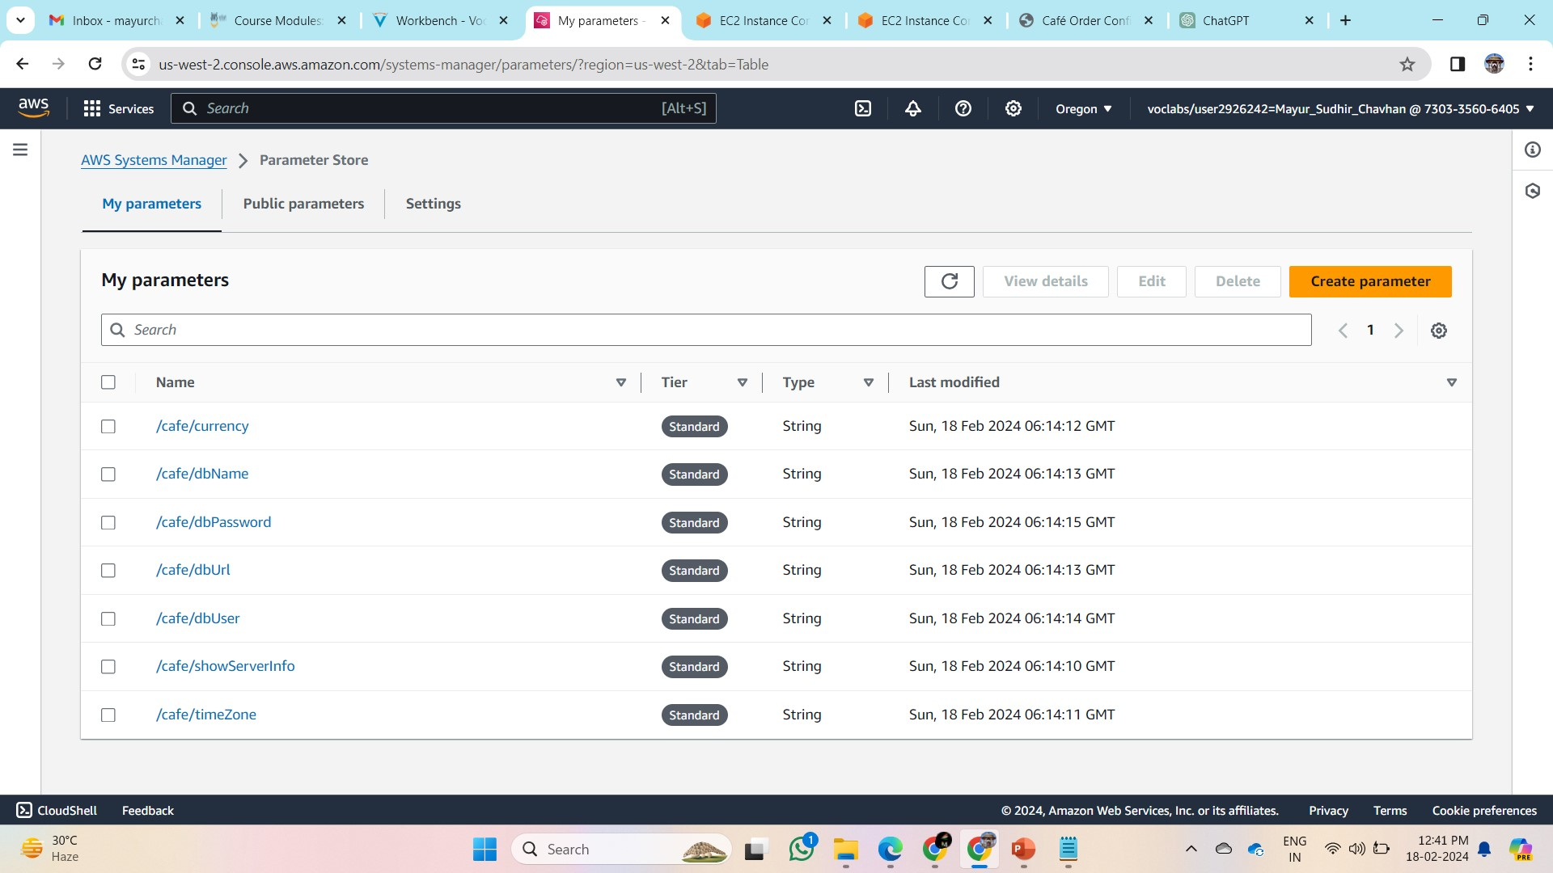
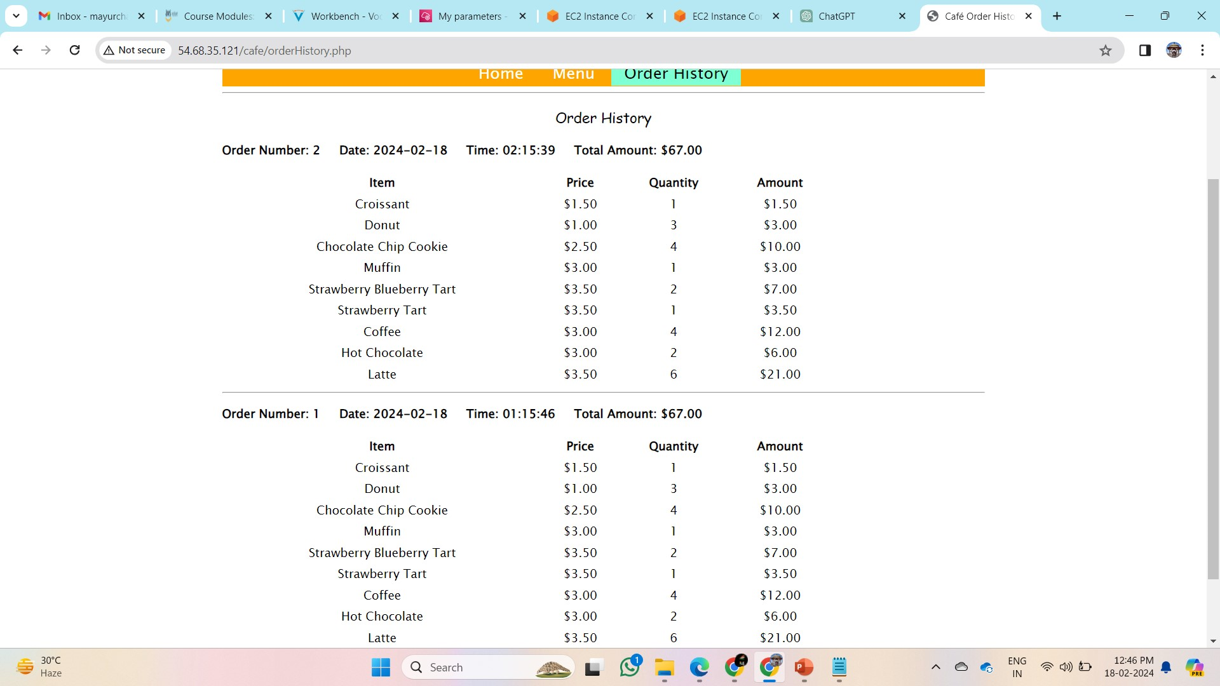
Step 4: Configuring the website to use the Amazon RDS instance
Update Database URL Parameter
Go to AWS Systems Manager.
Navigate to Parameter Store.
Choose /cafe/dbUrl from My parameters.
Edit and replace Value with RDS Endpoint Address.
Save changes.
Test Website
Open new browser window with CafeInstanceURL.
Confirm home page loads correctly.
→Check Order History tab for order count.
→Compare with pre-migration order count.
(Optional) Place new orders for verification.
Outcome

Slide 12
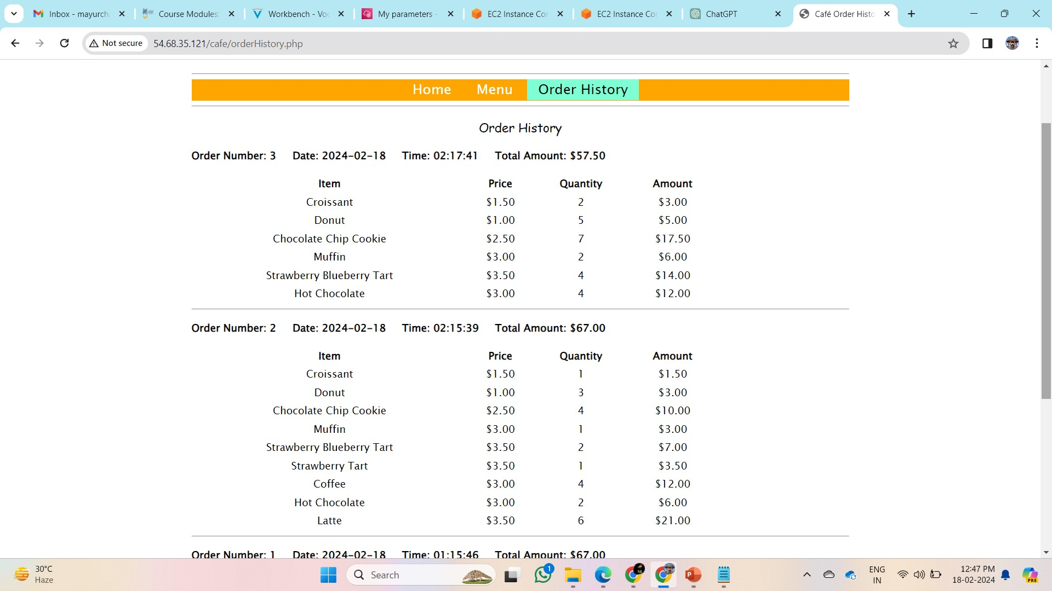
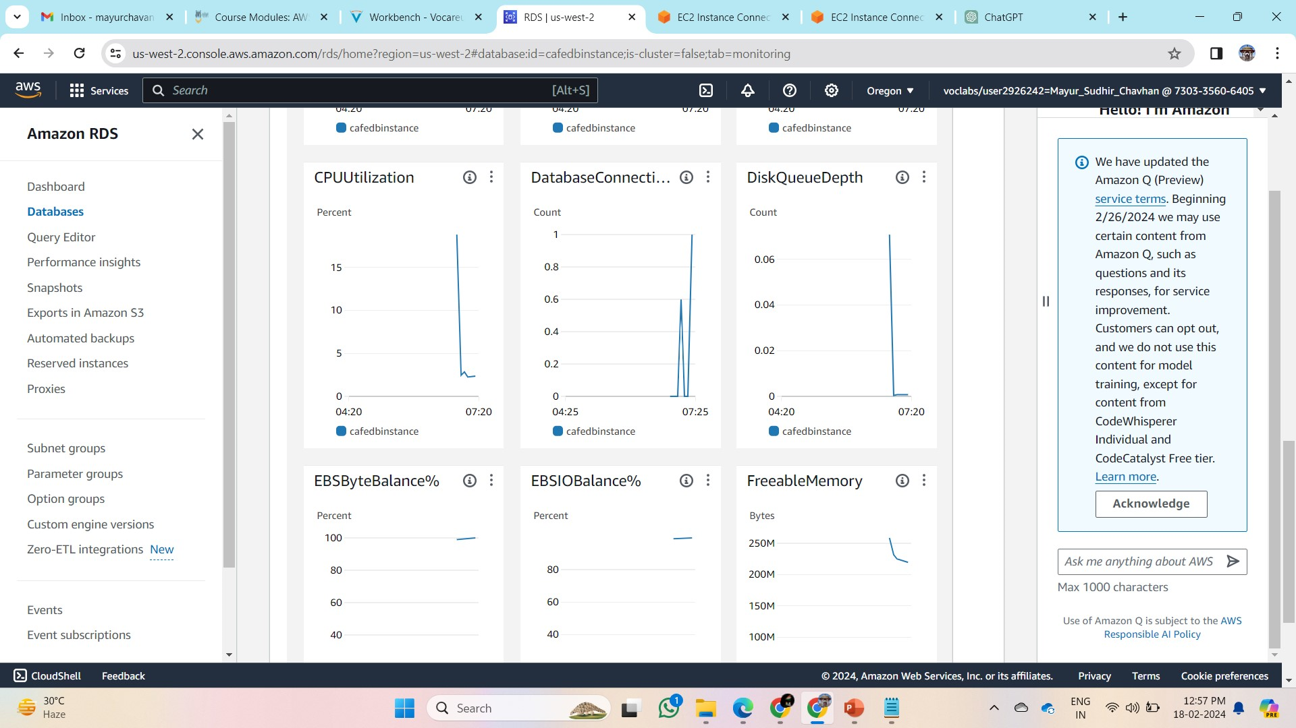
Step 5: Monitoring the Amazon RDS database
Accessing RDS Metrics-
Go to RDS Management Console.
Choose Databases and select cafedbinstance.
Navigate to the Monitoring tab.
→View default metrics like CPU utilization, database connections, storage space, memory, write/read IOPS.
→Monitoring Database Connections
Identify and monitor the Database Connections metric-
→Open an SQL session from CafeInstance.
→Retrieve data from the product table.
Observe the increase in the DatabaseConnections graph on RDS console.
→Closing Connection
→Exit the SQL session in CafeInstance.
→After 1 minute, refresh the DatabaseConnections graph.
→Confirm the decrease in the number of connections.
Exploring Other Metrics

Slide 13
Conclusion -
Created an Amazon RDS MariaDB instance by using the AWS CLI
Migrated data from a MariaDB database on an EC2 instance to an Amazon RDS MariaDB instance
Monitored the Amazon RDS instance by using CloudWatch metrics
**Note- For more information Visit https://github.com/Msc2905
Thank You

